Slide 1



Tactical Detection & Data Analytics Summit
Save the Date: December 4-11 Scottsdale, Arizona
sans.org/summit
SEC455 - SIEM Design & Implementation
SEC599 – Defeating Advanced Adversaries
SEC530 – Defensible Security Architecture
SEC555 – SIEM with Tactical Analytics
SEC511 – Continuous Monitoring & Security Operations
SIEM NetWars
SUMMIT
Dec. 4-5
TRAINING
Dec. 6-11
sans.org/summit
Notes:
Drag Picture and Send to Back

Slide 2
SEC530
Defensible Security Architecture
Data-Centric Security
Justin Henderson (GSE # 108)
@SecurityMapper

Slide 3

About Me
Justin Henderson | @SecurityMapper
SEC555/SEC530/SEC455 Author & Instructor
GIAC GSE # 108, Cyber Guardian Blue and Red
60 industry certifications
And security hobbyist and community supporter
Collecting interns/contributors in bulk (research teams)
Release research to the community

Slide 4
Welcome!
A copy of this talk is available at: https://github.com/HASecuritySolutions/presentations
More free stuff: https://github.com/HASecuritySolutions

Slide 5

Know Thy Organization
A defensible architecture requires organizational awareness
What are critical assets?
Where are the critical assets?
Why are they considered critical assets?
What do these assets need to function?
Knowing the above questions allows defenses to be built
Network-centric defenses build a security moat
Data-centric defenses secure the treasure in the castle

Slide 6



Full Stack Security
Applications rarely involve a single component
More likely multiple services make up one app
Consider a custom web application
May utilize an application server
Such as Java, Cold Fusion, Tomcat, or JBoss
Uses a web server
Stores and retrieves data from a database server
Securing application means securing the stack

Slide 7
Web Application Firewalls (WAF)
"A web application firewall (WAF) is an application firewall for HTTP applications" ~OWASP
Name implies simple to use prevention technology
A WAF is completely different than traditional firewalls
WAF is a reverse proxy or local module on a web server
WAF technology is helpful given:
Custom web applications do not have patches
Centralized security application of web servers is needed

Slide 8
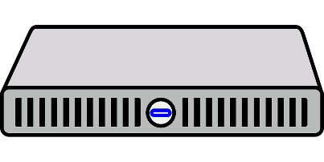
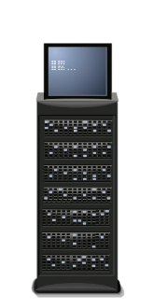
Central Web Server Protection
A key advantage of WAF is centralized protection
Possible to apply security policies across web servers
Examples:
Add HSTS headers
Fine-grained control of error pages
Controlling input validation
Multifactor authentication integration
CAPTCHA and rate limiting
Virtual patching

Slide 9
WAF Challenges
WAF is not completely foolproof
Methods exist to identify a WAF is in place (fingerprinting)
Multiple techniques exist to bypass WAF security
Potential WAF issues:
Each web server reacts differently to various requests
Many encoding techniques exist that are valid
Operating systems interpret paths differently
Multiple publicly available sources on how to bypass WAF

Slide 10
Database Monitoring and Controls
Critical data is often stored in a database
Database security is different than web security
Database security primarily deals with:
Controlling who can access data
Applying limits to data access
Identify sensitive data locations
Heavy detection focus

Slide 11
Data Encryption
Data at rest is still at risk of being stolen
USB drives, swappable drives, laptops, mobile devices
Portable media and devices are high risk
Accidental loss still constitutes a data breach
Ponemon¹ estimates cost per record between $71 and $380
Encryption at rest protects data from disclosure
Significantly decreases costs and risk of data breach
Implementation varies based on what is being encrypted

Slide 12
Encrypted Data
Assume stolen data or accidental loss of media
Encryption makes data unreadable
Now assume hacker gains remote access to server
Data is encrypted and mounted for user access
Does the hacker have access to the data? YES
Is the data cleartext or encrypted? Cleartext
Most encryption solutions do not protect mounted data
Includes plugged in USB drives and disk/database encryption

Slide 13
Content Discovery
Securing data requires knowing where data resides
Certain fields usually intended for sensitive data
SSN, Credit Card Numbers, Driver's license
Other fields are not supposed to but have sensitive data
Comments, Additional info, Notes
You must perform content discovery on a regular basis
Involves crawling through databases and file systems looking for data where it should not be

Slide 14
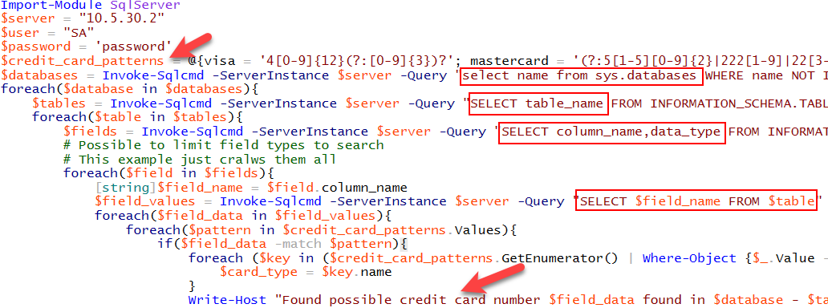
Content Discovery Script Example
Less than 40 lines of code including 10 lines of comments
Loops through each database, table, and column and checks all values

Slide 15
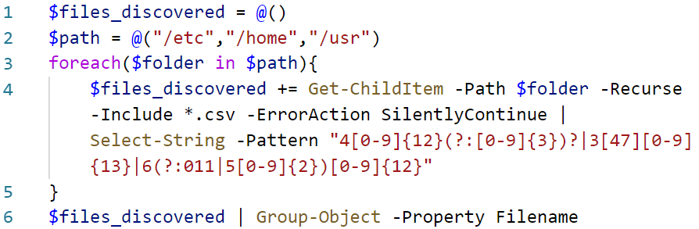
How to Find Key Data
PowerShell, Python, Bash, or insert_language_here
Commercial items work too (DLP, DAM, Casby)

Slide 16
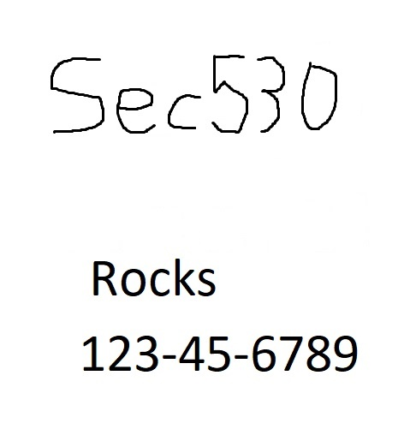
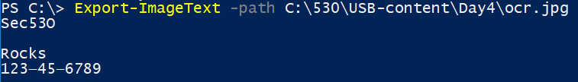
Optical Character Recognition (OCR) Integration
File classification supports OCR of TIFF (faxes and scans)
Vendor solutions have more file support and OCR capabilities
Possible to live off the land with PowerShell
Find certain files such as JPG
OCR scan them looking for sensitive data
If sensitive content found add file property
Can be integrated into automatic classification

Slide 17

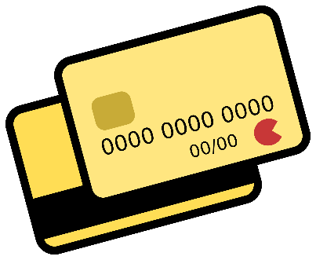
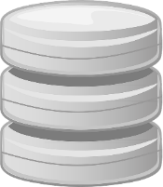
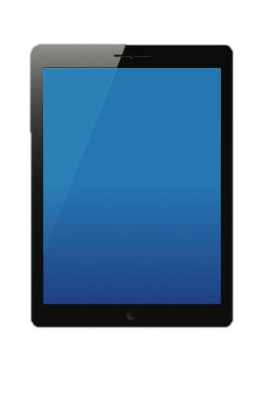
Acceptance
First task is to identify key data and where it is expected
File servers
Database servers
USB drives
Next, is to realize where it may end up
Laptops
Mobile phones
Personal USB devices
Expected
Probable
reality

Slide 18
File Classification
To control and audit sensitive files requires classification
D:\pci_share\530_backup.xlsx <- Contains PCI
Maybe files in pci_share are expected to have PCI data
File server is properly segmented and intended for PCI
Yet user with read access can copy it to local box
Assume you saw a file called 530_backup.xlsx on a desktop
Would you assume it had credit card data?
File classification adds tags to identify and control files

Slide 19
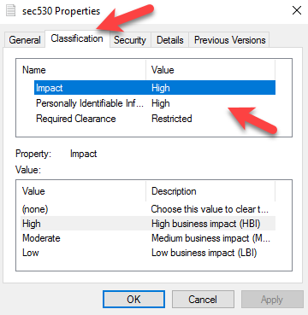
Windows File Classification Infrastructure (FCI)
Server 2008 R2 and later supports file classification
Requires File Server Resource Manager (FSRM) role
Allows assigning properties to files
Properties can be anything
Clearance required
Level of PII
Whether something is PCI or EPHI
Date something occurred
Impact of disclosure

Slide 20
Alternate Data Streams (ADS)
File classifications are stored in alternate data streams
Feature of NTFS that allows data to be attached to existing data
C:\>streams64.exe C:\test\sec530.txt
C:\test\sec530.txt
:FSRM{ef88c031-5950-4164-ab92-eec5f16005a5}:$DATA 234
PS C:\> get-content -path C:\test\sec530.txt -Stream "FSRM{ef88c031-5950-4164-ab92-eec5f16005a5}"
îC8àBŠ>«N±a$íh,Î%!Ò|n|Ì‰Óê 8 h*Á‘ny<Ô¬È5Û mB…üyËxN² @ . $ I m p a c t M S 3 0 0 0 @ ( P I I _ M S 5 0 0 0 @ D : R e q u i r e d C l e a r a n c e _ M S 3 0 0 0

Slide 21
Moving Files
File classification is designed for Windows file servers
What happens when the file gets moved?
Copy to NTFS drive keeps properties but may not use them
Copy to other file systems such as FAT32 and properties are lost
SharePoint and Office 365 integrate with FCI
Restrictions can be applied to documents using properties
Commercial DLP solutions replace or integrate with FCI
May be necessary for classification with certain file types or applications

Slide 22
Azure Information Protection
Microsoft file classification is integrated into multiple cloud products
Office 365 and SharePoint Online support FCI
Microsoft is pushing Azure Information Protection (AIP)
Similar to AD Rights Management Services (RMS) (on premise)
Neither Azure Information Protection or AD RMS are free
But Azure Information Protection may be part of your subscriptions
Information Protection classifies data similar to FCI
But properties and content are handled completely different

Slide 23
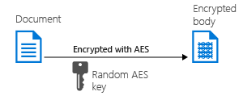
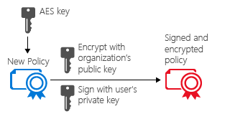
Azure Information Protection (AIP)
Alternate data streams can be removed with ease
To secure data and file properties, AIP may use encryption
Each document is encrypted with new AES key
Key and file properties and restrictions are encrypted with organization's public key
Users private key used to sign document

Slide 24
Classify and Protect Example
PS C:\> Get-Content -Path C:\test.txt
ABCD
PS C:\Users\jhenderson\Downloads> Get-Content -Path C:\test.ptxt
This file uses Microsoft Information Protection solutions. Open it using an application that supports protected files. You can download Microsoft's protected file viewer from: http://go.microsoft.com/fwlink/?LinkId=280381 Learn more about Information Protection solutions at http://www.microsoft.com/rms
Do not change this file in any way -- doing so will result in data loss.
0 Ï Ó Ú· ±Ï ­¹ .txtï»¿<?xml version="1.0"?><XrML version="1.2" xmlns=""><BODY type="Microsoft Rights Label" version="3.0"><ISSUEDTIME>2018-01-11T06:51</ISSUEDTIME><DESCRIPTOR><OBJECT><ID type="MS-GUID">{e96c13aa-570b-4b28-ae24-fba735f8d462}</ID><NAME>LCID 1033:NAME Confidential \ inance:DESCRIPTION Confidential data that contains financial information that is restricted to employees only.

Slide 25
Dynamic Access Control (DAC)
Simple access control lists are insufficient
Group membership is hard to control and inflexible
Other details need to factor into access
What device is being used?
Who is accessing device and what attributes do they have?
How does this apply to file classifications?
Access controls need to be calculated on-the-fly
Microsoft's uses Dynamic Access Control

Slide 26
Advanced Access Example
Start
Access Requirements:
Device must be using Windows 7 or later
User must complete annual HIPAA training
User must be in HIPAA Users group
Request Healthcare File
Pass ACL
Yes
Yes
HIPAA Training
Yes
Access Allowed
Windows 7 or later
No
No
No
Deny Access
Deny Access Custom Error
Deny Access Custom Error

Slide 27

Due Diligence
The more responsibilities a cloud provider has, the higher the need for due diligence checking
Cloud provider policies and processes must be scrutinized
Does the provider have a SOC report?
Helps establish minimum baseline
Who has access to your corporate data within the provider?
Do you have the right to audit or pentest your tenant?
Or can they prove routine auditing and penetration testing?

Slide 28
Tactical Detection & Data Analytics Summit
Save the Date: December 4-11 Scottsdale, Arizona
sans.org/summit
SEC455 - SIEM Design & Implementation
SEC599 – Defeating Advanced Adversaries
SEC530 – Defensible Security Architecture
SEC555 – SIEM with Tactical Analytics
SEC511 – Continuous Monitoring & Security Operations
SIEM NetWars
SUMMIT
Dec. 4-5
TRAINING
Dec. 6-11
sans.org/summit
Notes:
Drag Picture and Send to Back

